Slide 1

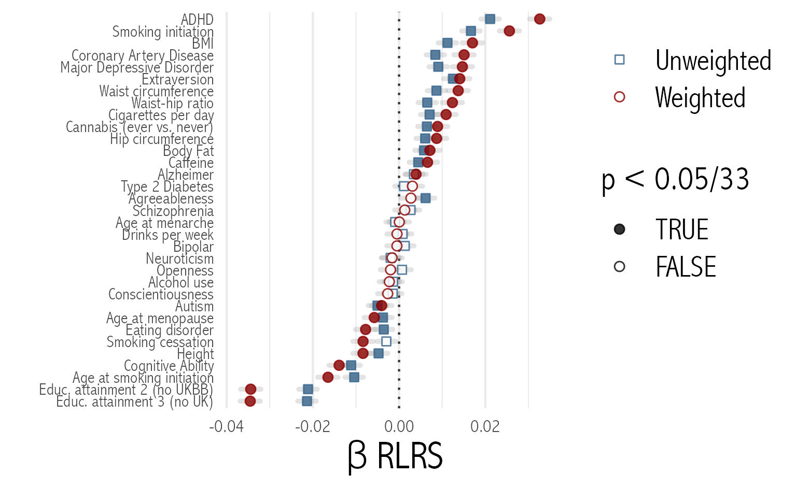
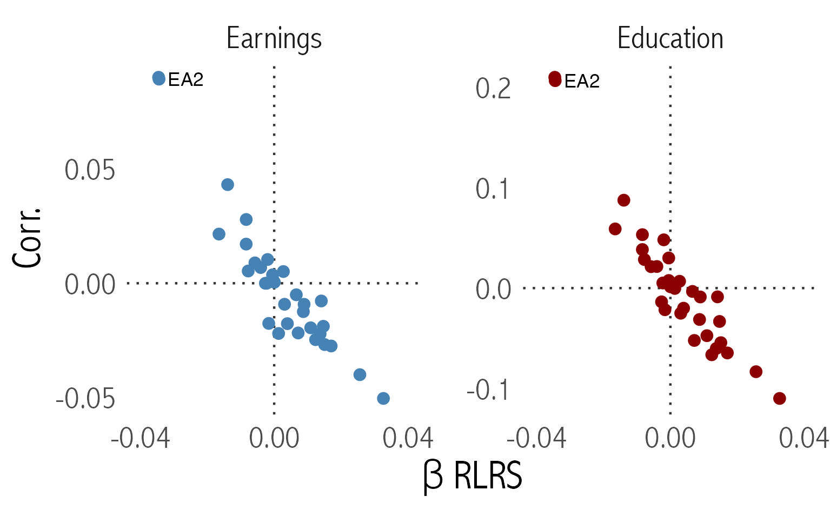
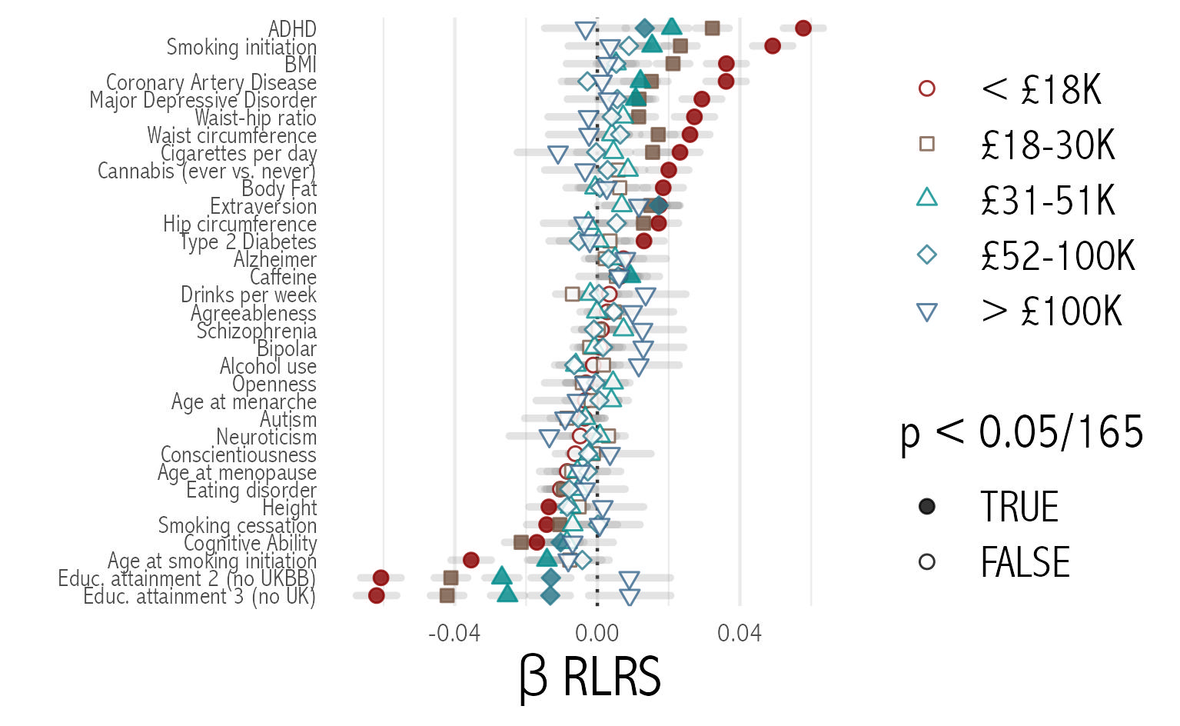
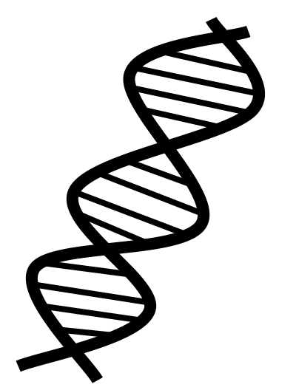


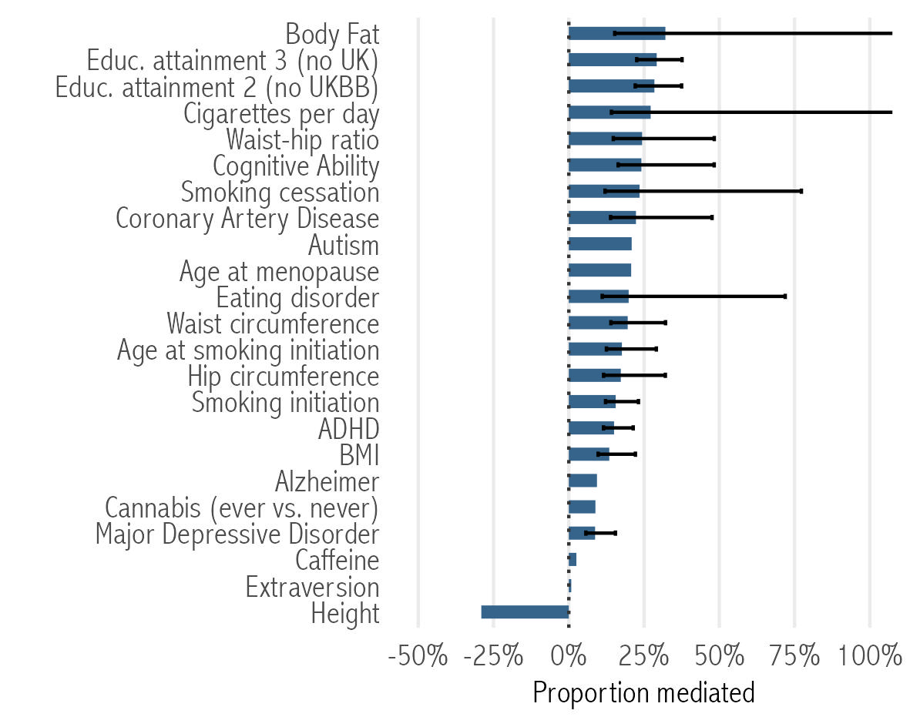



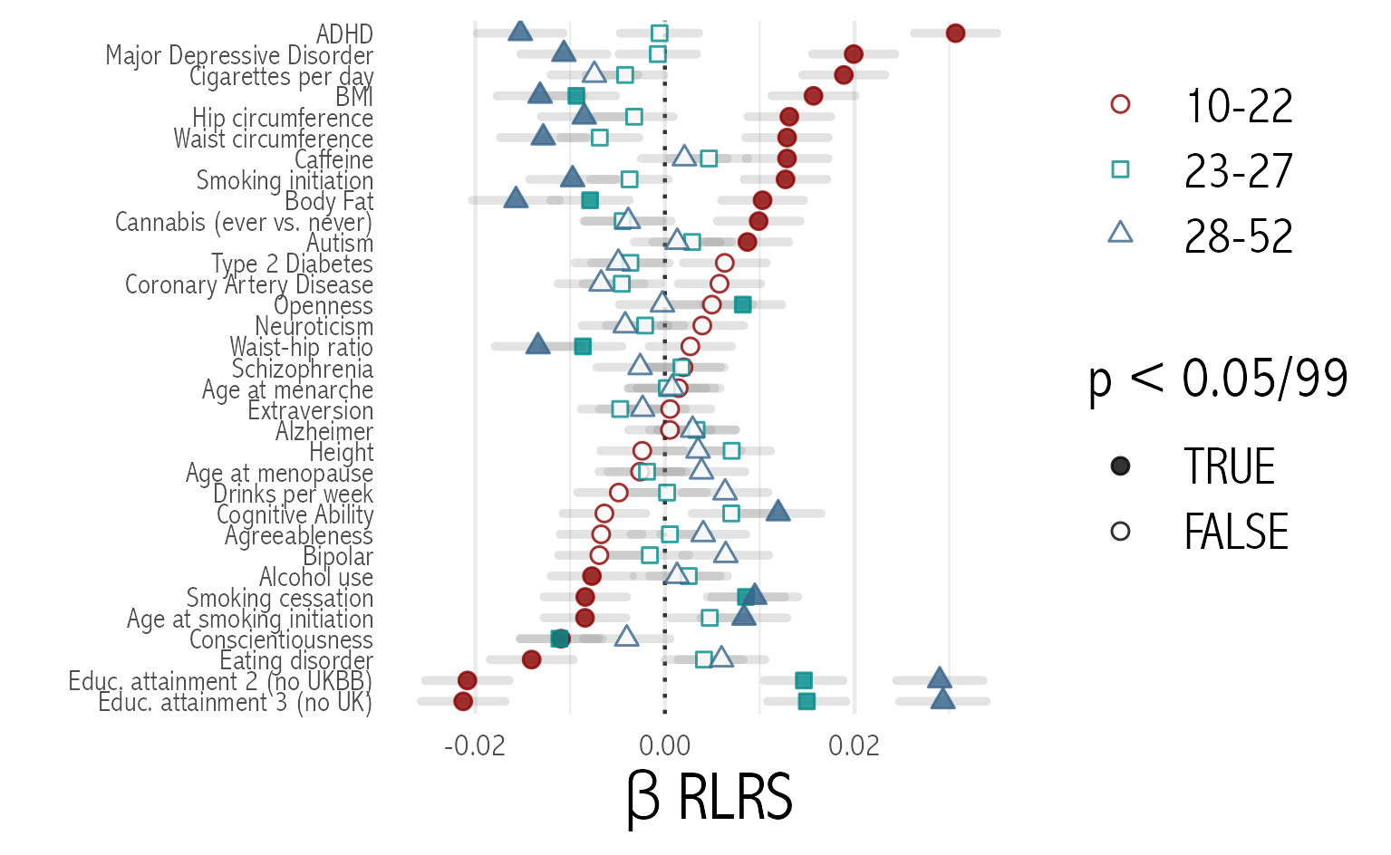
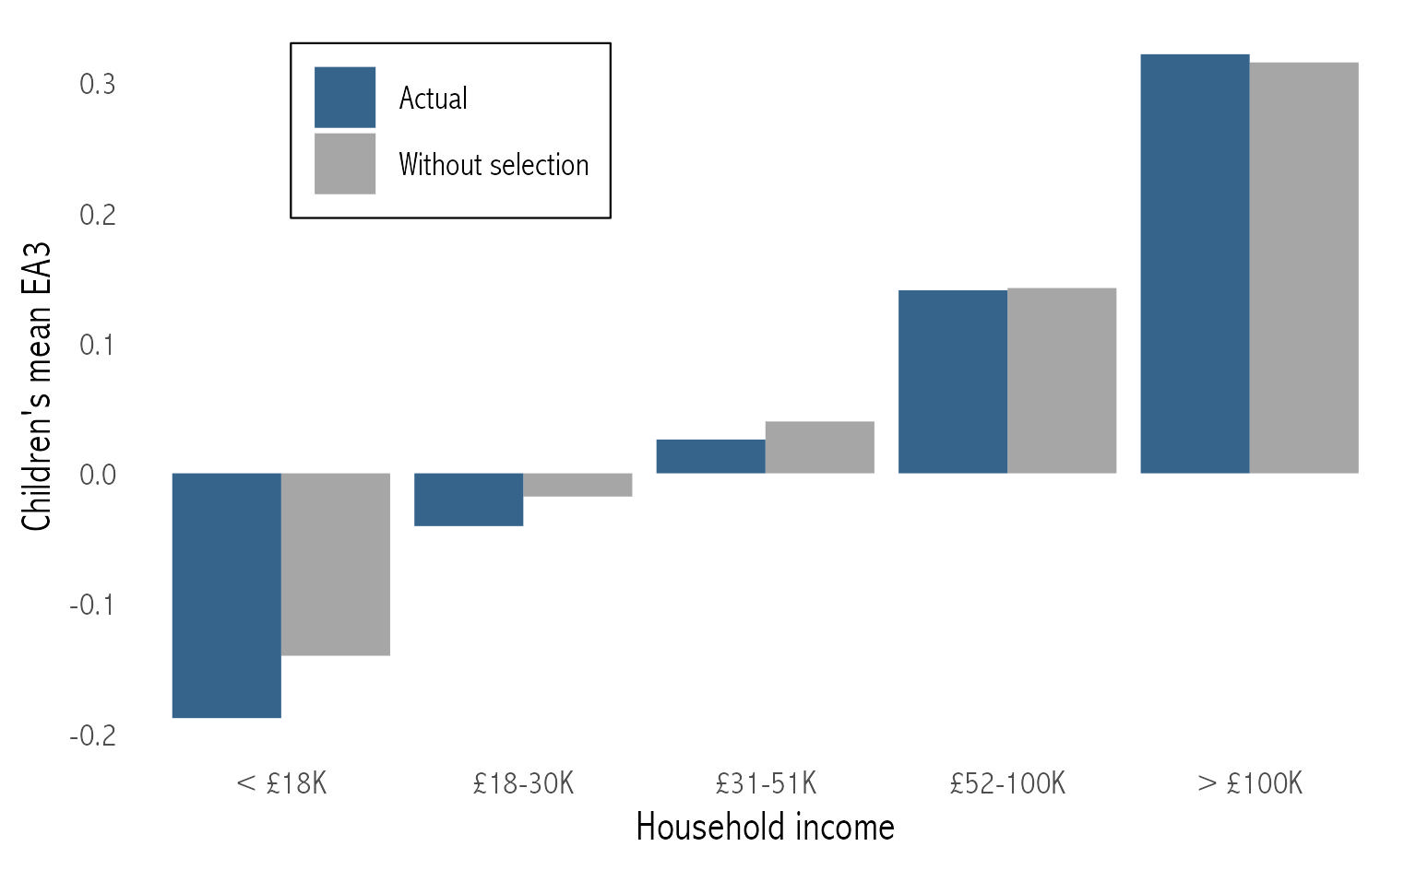
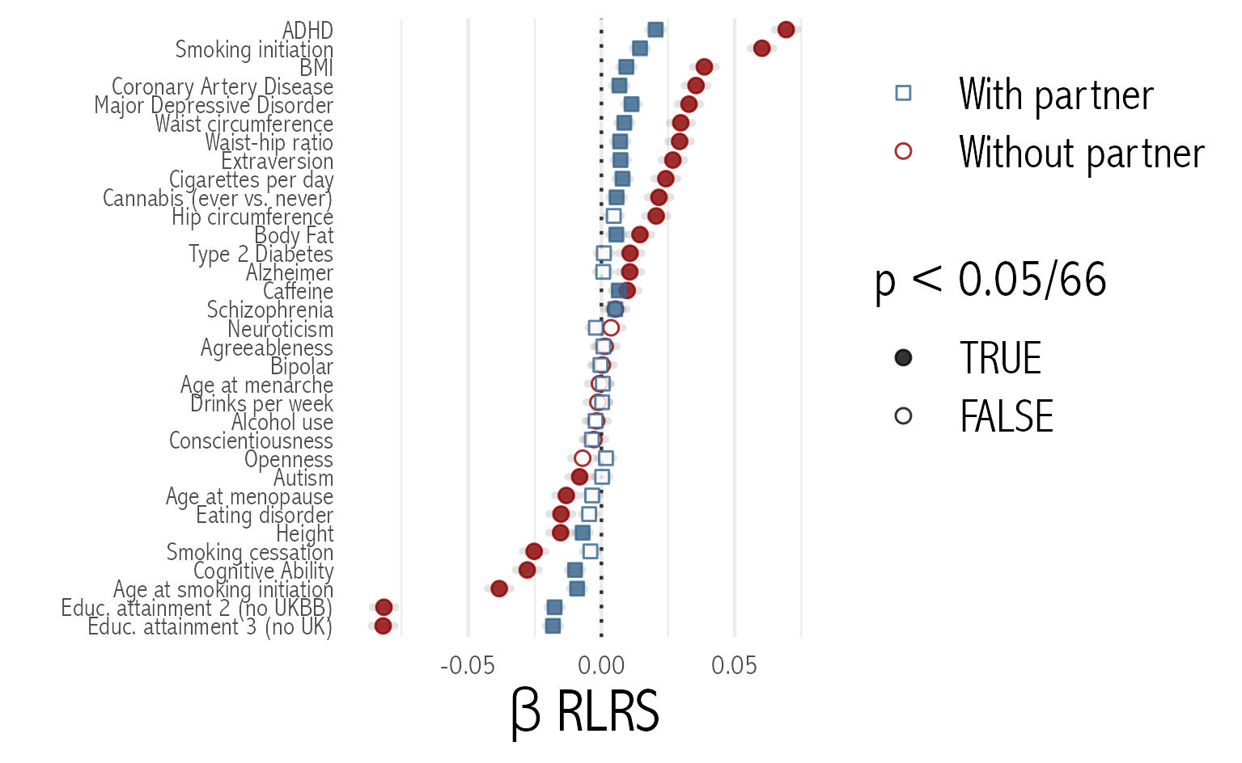
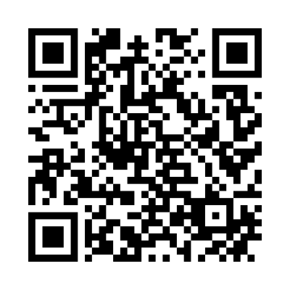
Human capital mediates natural selection in contemporary humans
David Hugh-Jones University of East Anglia davidhughjones@gmail.com @davidhughjones
Abdel Abdellaoui Amsterdam UMC a.abdellaoui@amsterdamumc.nl @dr_appie
Polygenic scores predicting lower earnings and education are being selected for
Among 348,595 UK Biobank respondents with completed fertility, we correlate 33 polygenic scores with relative lifetime reproductive success (RLRS).
Effect sizes are equal to the expected normalized polygenic score in the next generation.
Effect sizes are highly correlated across two generations, using number of siblings to calculate parents’ RLRS.
Population weighting (Van Alten et al. 2022) increases effect sizes.
Effects vary by…
Economic theory of fertility can explain these results
Income and education
Polygenic scores correlate with earnings-increasing human capital. This has two effects on fertility…
… a fertility-increasing income effect: children become more affordable.
… a fertility-decreasing substitution effect: time spent on children has a higher cost in foregone earnings.
Age at first live birth (women)
correlations reverse among older mothers
This model can explain the patterns in our data, if the substitution effect is stronger at lower income levels. A mediation analysis shows that education significantly mediates the link between polygenic scores and fertility for 18/23 scores where there is a significant link.
Natural selection increases genetic inequality across income groups
Selection against earnings-increasing variants is stronger at lower incomes. This increases inequality between income groups, and the unfairness of the genetic lottery (Harden 2021). Natural selection increases the correlation of polygenic scores with income for 28 out of 33 scores, with a median increase of 16.43%.
Living with a partner
and number of lifetime partners
Acknowledgements
AA is supported by the Foundation Volksbond Rotterdam and by ZonMw grant 849200011 from The Netherlands Organisation for Health Research and Development. This study was conducted using UK Biobank resources under application numbers 40310 and 19127.
Weighting data was kindly supplied by Van Alten et al. (2022).
Code for the paper and poster is available at https://github.com/hughjonesd/why-natural-selection.

